Slide 1
An Intro to Distributed Quantum Computing
Maria Gragera Garces
June 2026

Slide 2
What? & Why?
Multiple quantum computers interconnected* to perform a joint computation larger than their individual capacities.

Slide 3
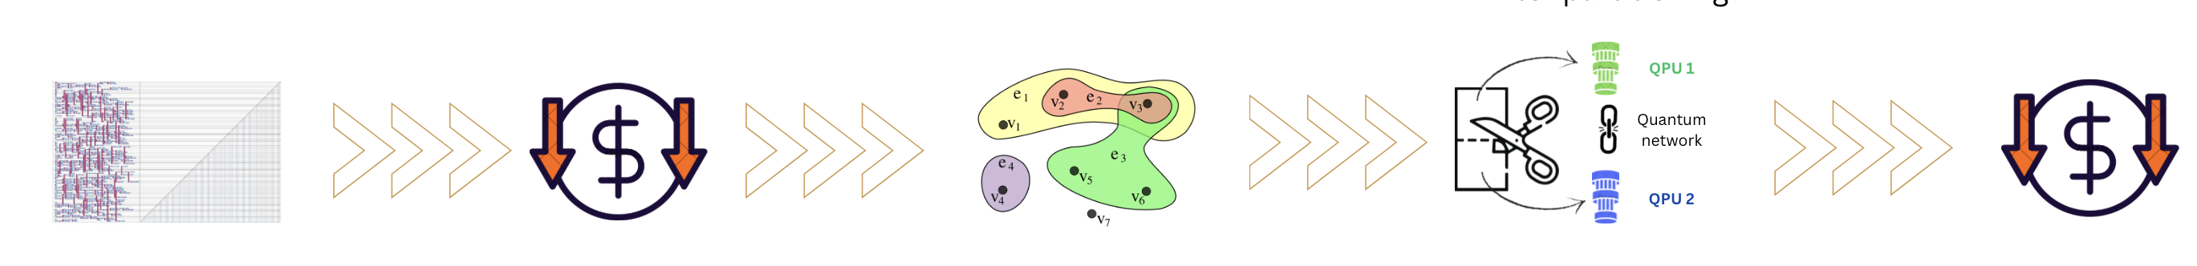
How
Large computation
Abstraction
Partition & Assignment
To QPUs in the network

Slide 4
How?
Large computation
Abstraction
Partition & Assignment
To QPUs in the network
Circuit
MBQC Pattern
Quantum Walk
…
Hypergraph
Some version of the BHP
Circuits:
Vertices: Qubits
Edges: Gates

Slide 5
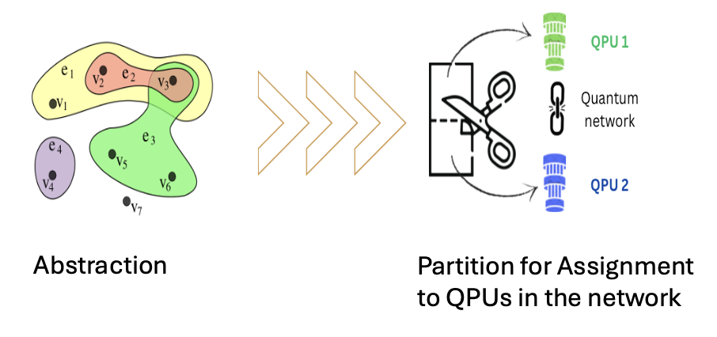
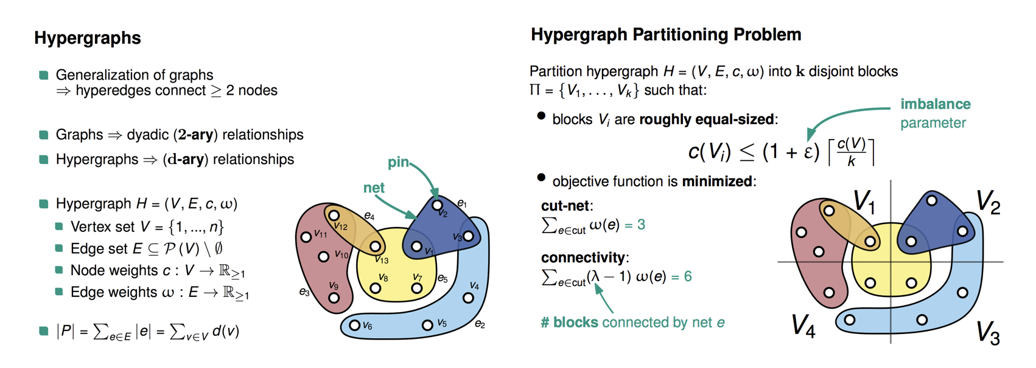
Balanced Hypergraph partitioning
Figure taken from kahypar.org

Slide 6
Balanced Hypergraph partitioning
Figure taken from kahypar.org

Slide 7

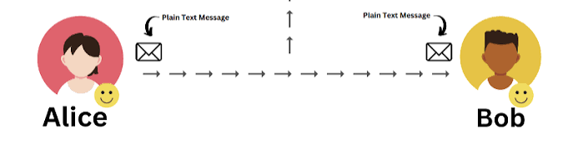
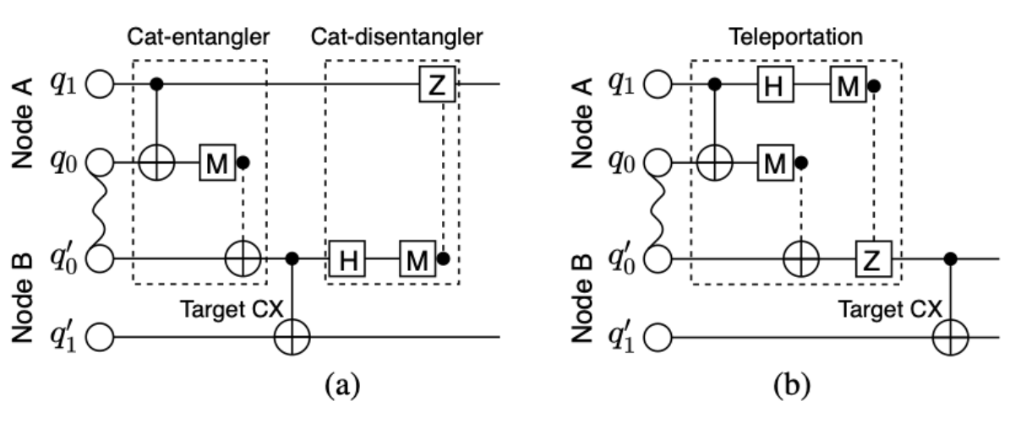
Inter-partition hyperedges: non-local gates
Figure taken from AutoComm: A Framework for Enabling Efficient Communication in Distributed Quantum Programs

Slide 8
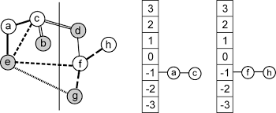
Balanced Hypergraph partitioning: FM solver
Fiduccia-Mattheyses: works by maintaining a priority queue of nodes sorted by their "gain" (how much moving a node to another partition would improve the cut).
At each step, you pick the node with the highest gain, move it, lock it (you don't get to move it again in this pass), and update the gains of neighboring nodes.
You keep going until all nodes are locked, then you roll back to the best solution you saw during the pass.
At that point you unlock everything and do it all over again until you stop seeing improvements.

Slide 9
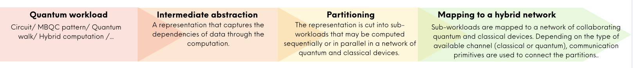
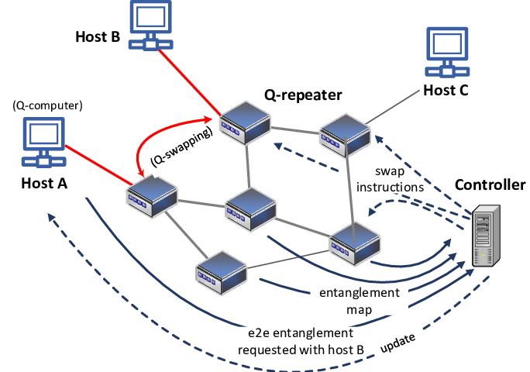
BHP is a simplification not the whole story
INPUTS
Large computation
Device network: topology, device capacities, channels, …

Slide 10
This is not just routing
Resource currency: Routing burns SWAP gates on a fixed coupling graph (cost = SWAP depth). DQC burns ebits (Bell pairs) + classical bits; you minimize entanglement cost and communication rounds.
What actually moves: Routing physically transports the state through the array. In gate teleportation, data qubits stay home; only entanglement is consumed and outcomes are sent.
Probabilistic link layer: SWAPs are deterministic and coherent. Inter-module entanglement is heralded and probabilistic (photonic links), adding a stochastic stack: generation attempts, buffering, purification.
Optimization is partitioning, not embedding: Routing embeds a circuit into a fixed topology and minimizes SWAPs. DQC partitions the circuit across modules to minimize the cut (non-local gates), then schedules entanglement. A cat-entangler lets one ebit drive many controlled gates.
Routing is graph embedding under a fixed lattice. DQC is an LOCC resource theory across a network.
Calling it "routing" hides the ebit accounting, the probabilistic link layer, and the classical feed-forward.

Slide 11
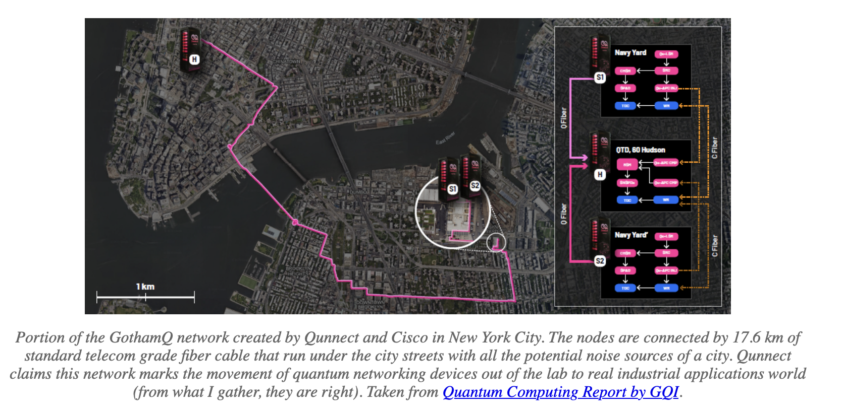
Current state

Slide 12
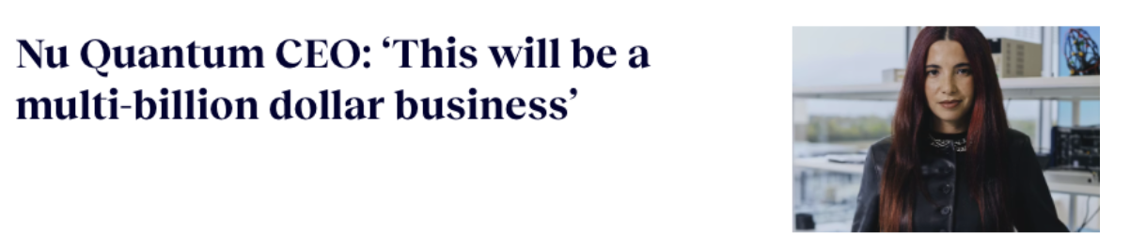
Current state

Slide 13
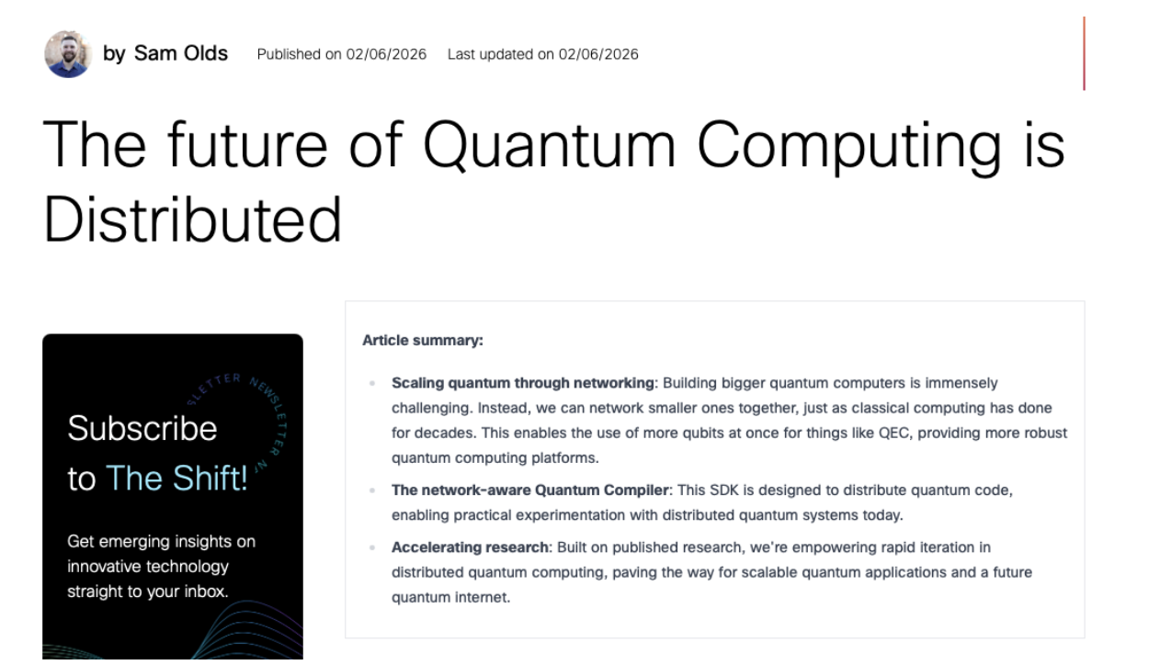
Current state

Slide 14
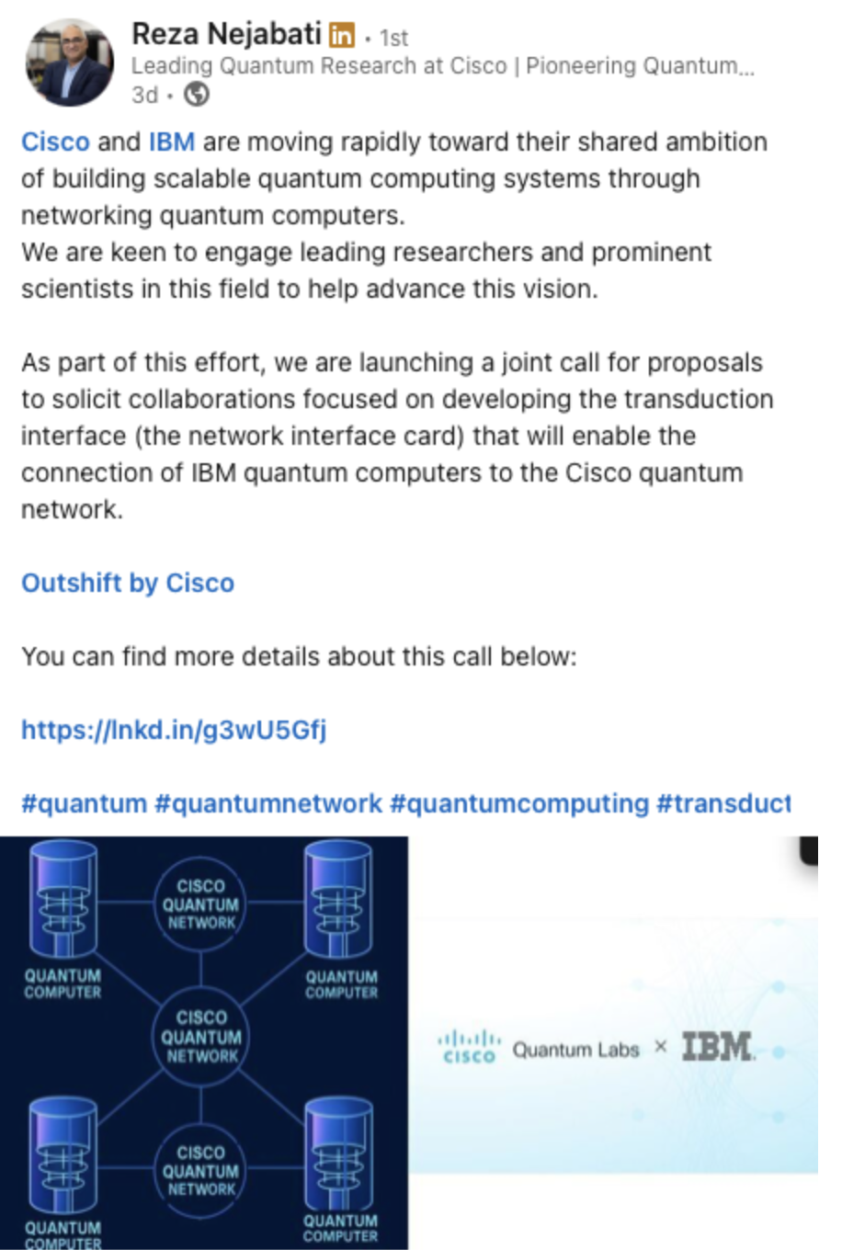
Current state

Slide 15

Roadmap of the field: Near-Term
Step 1) Cross-campus DQC
Reasonable Compute

Slide 16
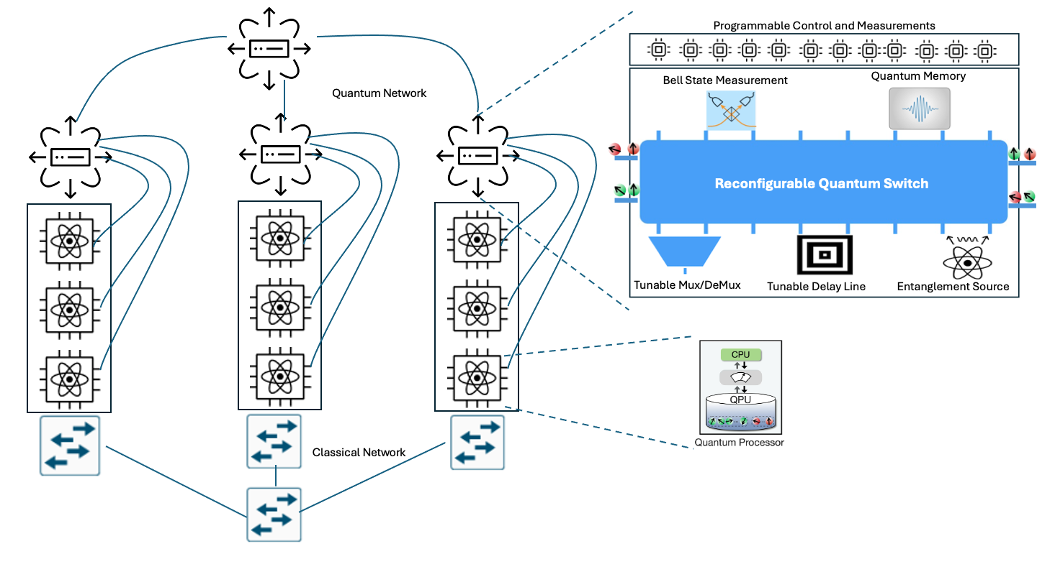
Roadmap of the field: Near-Term
Step 2) Quantum Data centers
Figure taken from Cisco research

Slide 17
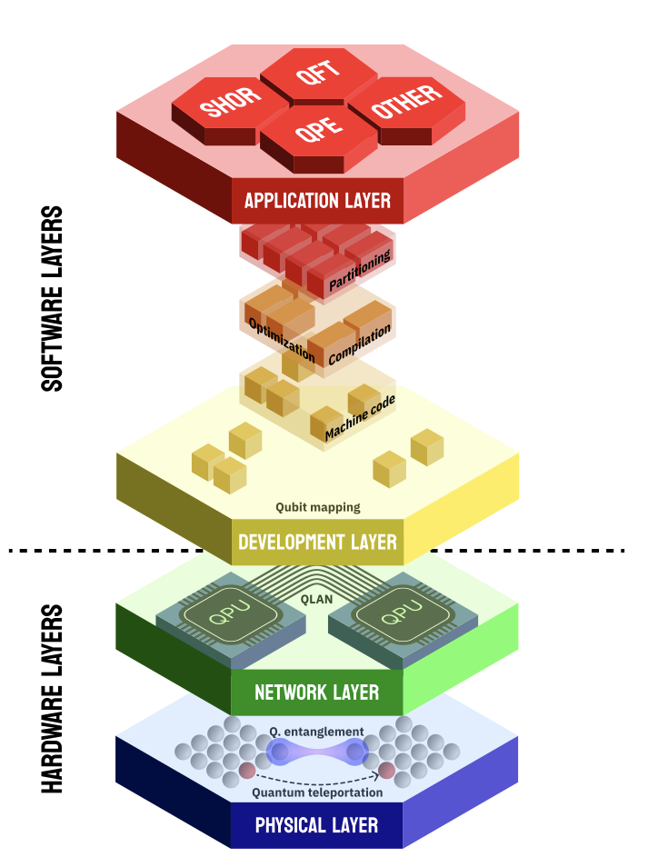
Figure taken from Review of Distributed Quantum Computing: From single QPU to High Performance Quantum Computing

Slide 18
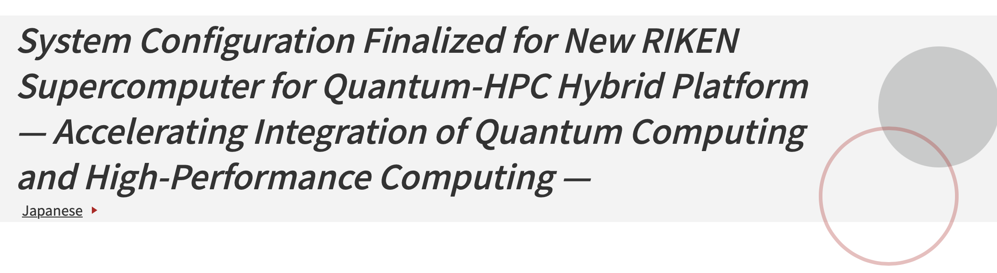
Roadmap of the field: Long-Term?
Step 2) Hybrid Data centers
Figure taken from www.r-ccs.riken.jp

Slide 19
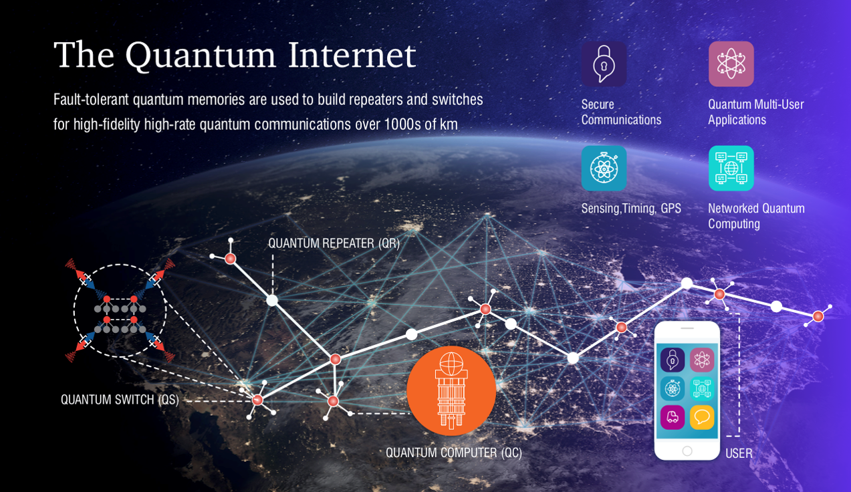
Roadmap of the field: Long-Term?
Step 3) The Quantum Internet

Slide 20
Classical counterpart
1960s — mainframes, time-sharing (one big box)
1969 — ARPANET: computers start talking
1973 — Ethernet: local networks
1980s — client-server, first clusters
1994 — Beowulf clusters (cheap nodes + network = supercomputer)
2004 — Google MapReduce: data center as one computer
2006 — AWS: cloud = distributed-by-default
2014 — Kubernetes: orchestrating 1,000s of nodes
2020s — distributed AI training at hyperscale
Classical compute is distributed

Slide 21
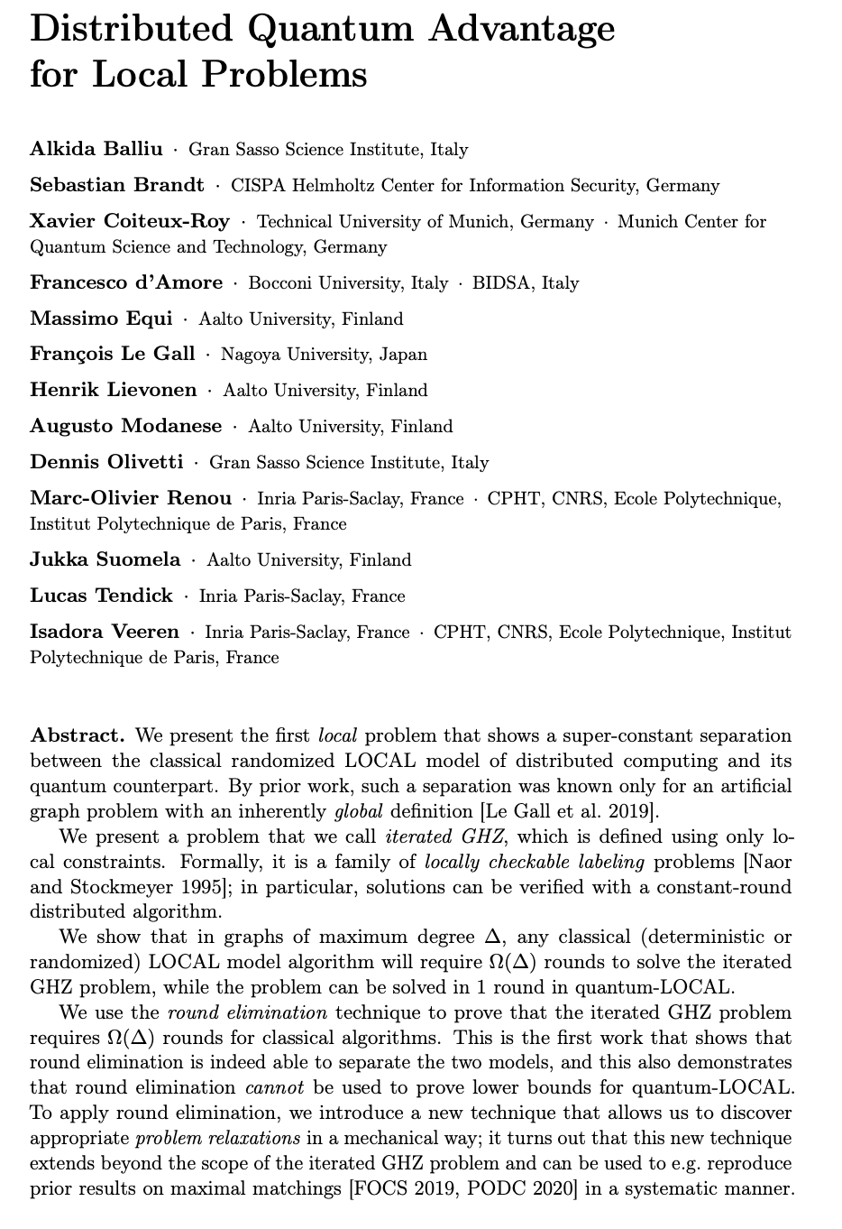
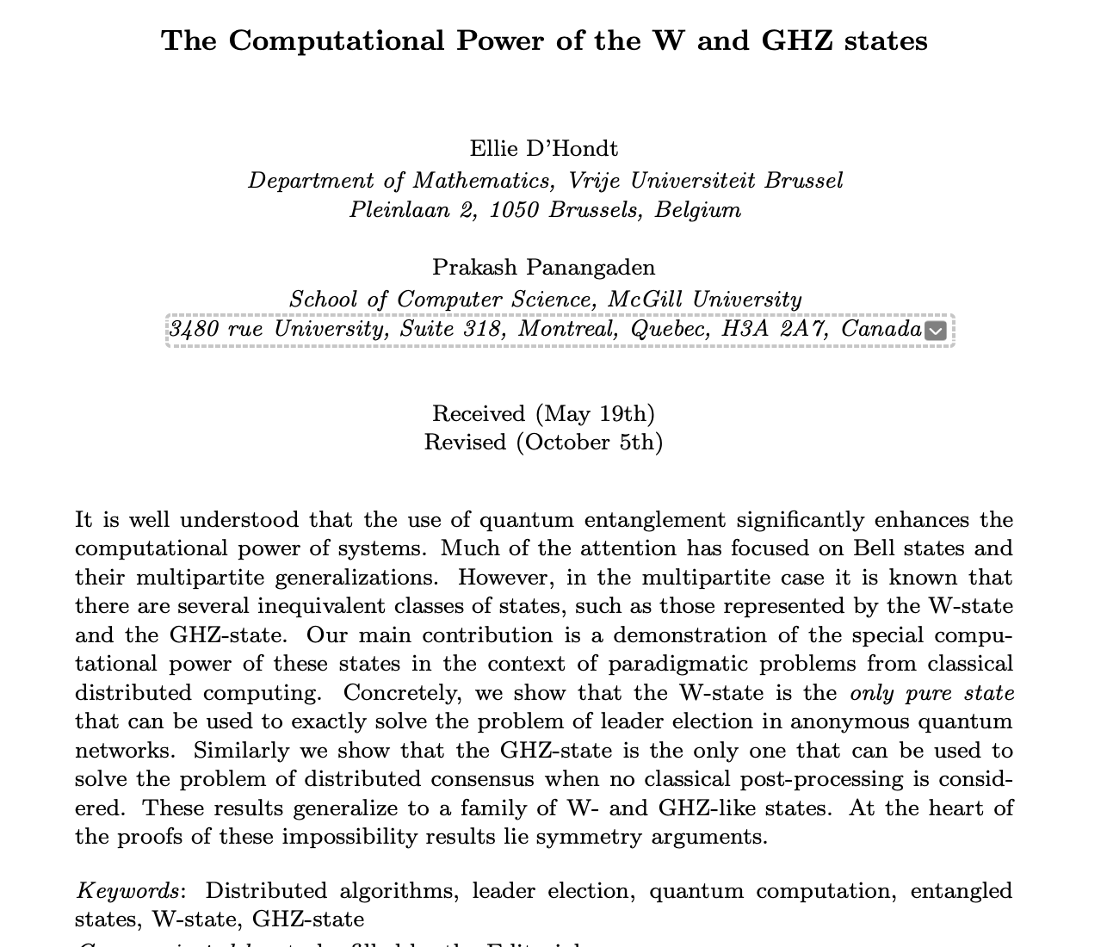
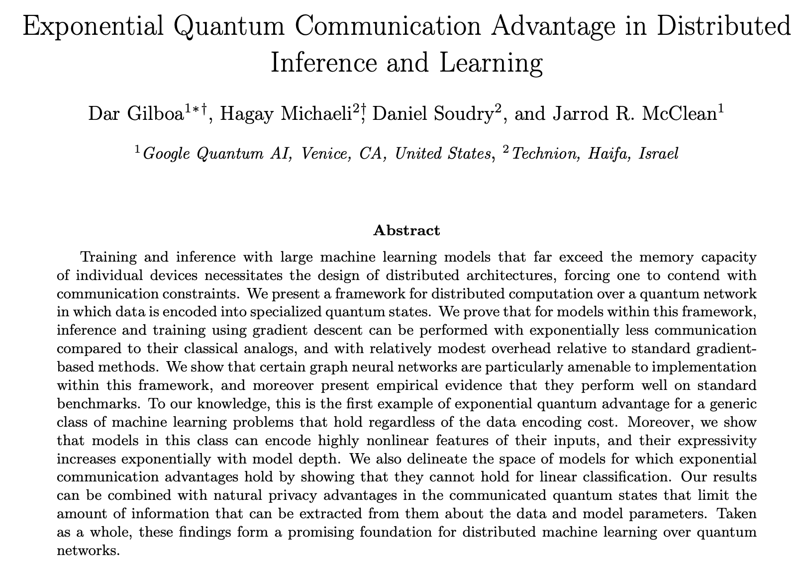
Advantage in Distributed settings

Slide 22
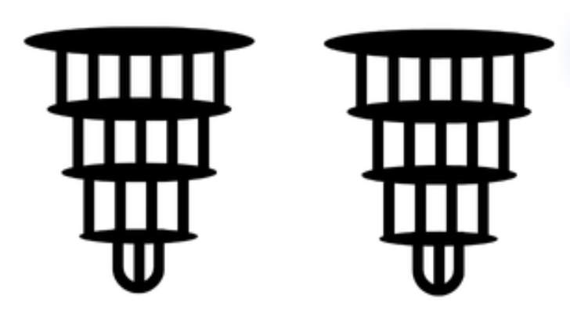
Our old enemy: noise
Quantum computation is fundamentally limited by noise. In a distributed setting, this challenge compounds.
More QPUs → more communication → more noise.
QPU noise
Network noise
QPU noise

Slide 23
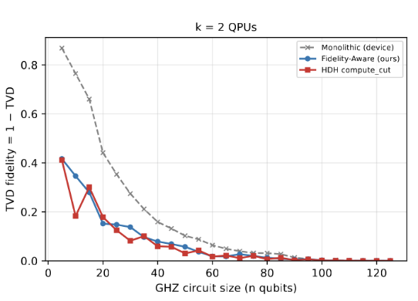

Our old enemy: noise
Total
Variational
Distance

Slide 24
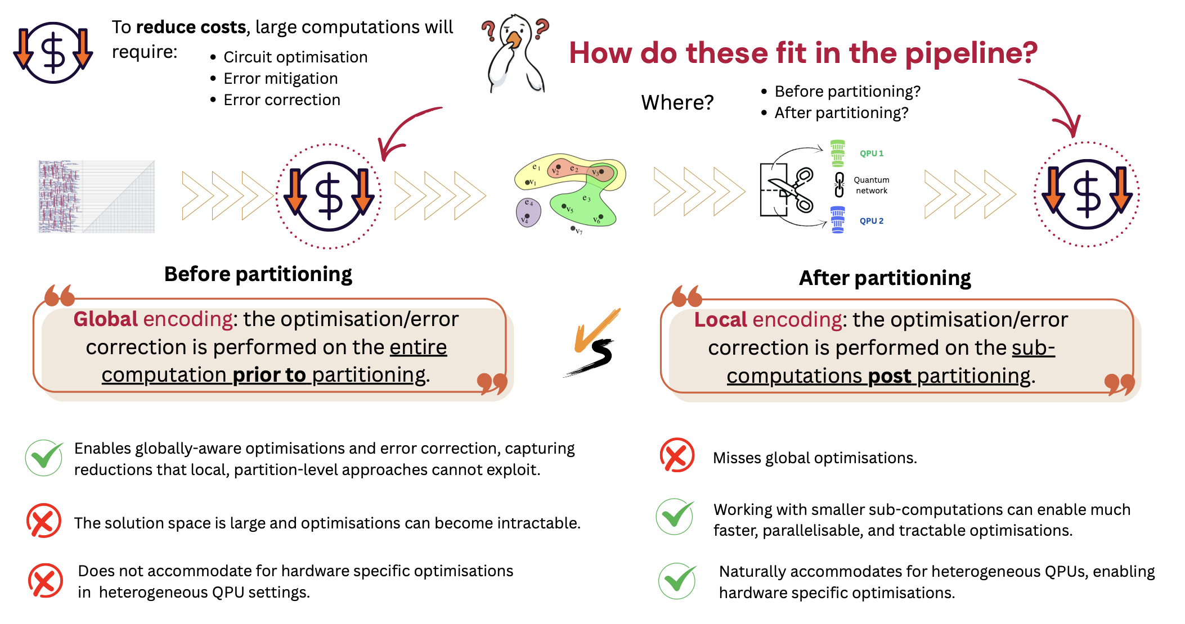
Standard quantum computing compiling

Slide 25

An Intro to Distributed Quantum Computing
Maria Gragera Garces
HACKMONTH 2026

